Slide 1
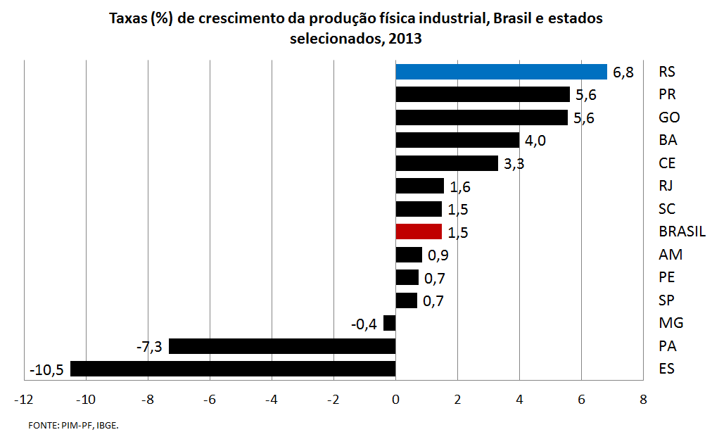

Slide 3
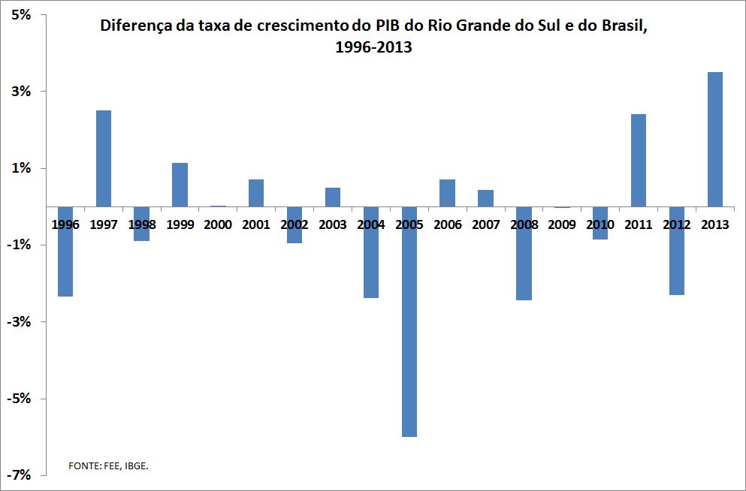

Slide 4
http://www.fee.rs.gov.br

